Slide 1
Email like a pro!
CHAPTER 2: EXPLORE THE IT INDUSTRY

Slide 2

OBJECTIVES FOR THIS SESSION
Understand the email good practices
Write your own email depending on different scenario
Analyze the email written by your peers

Slide 3











ENGAGE
What are the 8 etiquettes from the video?
5 MIN

Slide 4
EXPLAIN
What are the 8 etiquettes from the video?
5 MIN
One project = one thread
Subject line = call to action
Manage recipients
Settings: simple reply
Summarize messy email
1st = main point
Settings: 30 sec undo
Hyperlink

Slide 5

EXPLAIN
Subject line = Call to action
5 MIN
In the CTA, you’ll need to include:
What the recipient should do
(Optional) Time required to complete (Depending on the working culture/ nature of email)
For example:
[5 Minute Survey] Feedback for Project X
Request for Project X budget
Include CTA in the subject line
CTA = Call to Action

Slide 6

Practice including CTA on subject line
ACTIVITY 1
10 MIN
Choose one of the following prompts to work on:
You need to request the participants’ list for PNC Khmer New Year Party
You need to ask for a budget proposal for Project Y
TO COMPLETE THIS ACTIVITY :
1
INDIVIDUAL WORK
(5 min)
2
PEER REVIEW
(5 min)

Slide 7


EXPLAIN
Managing your emails
5 MIN
Stick to one email chain for the same topic
E.g. new ideas, follow-up questions
One email thread per topic
Explain why you add or take out recipient(s)
Added at the top of the email in an italicised font
Recipient management
(Depends on situation)

Slide 8

EXPLAIN
Body of the email
5 MIN
How?
The content after the salutations should be clear from the beginning
The word ‘CONTEXT’ can be removed
Why?
Gives people the option to read the not-so-important part of the email 🡪 More efficient
It may seem polite and respectful to give the context, but focus on the solution (= purpose of writing the email)
Main point first, then context

Slide 9
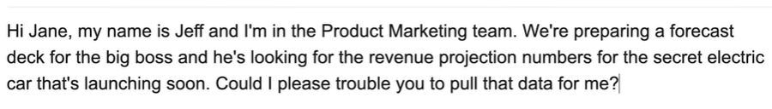
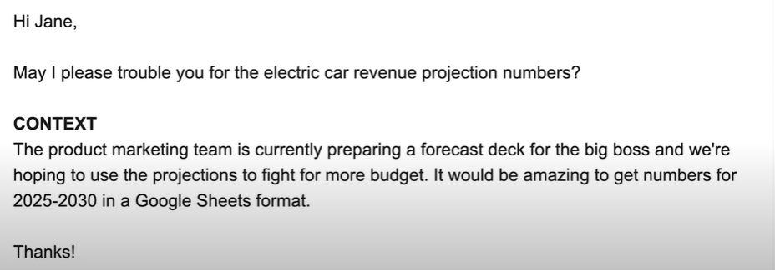

Slide 10
ACTIVITY 2
Practice putting the main point first
10 MIN
How will you start the email if you face the following situation?
Your manager asks you to send an email to the supplier, Mr O’Brian to see when the ordered goods from the UK arrive.
He needs this information to follow up on the implementation of a new product in the company
TO COMPLETE THIS ACTIVITY :
1
INDIVIDUAL WORK
(5 min)
2
PEER REVIEW
(5 min)

Slide 11
EXPLAIN
Summarize the messy email in your reply
5 MIN
This happens when you receive a messy email…
Summarise their ideas
Respond to their request
Why? (It’s their job to write good emails, right?)
Confirms your understanding of the email is correct
The sender would appreciate your extra effort of helping them to organise their thoughts!

Slide 12
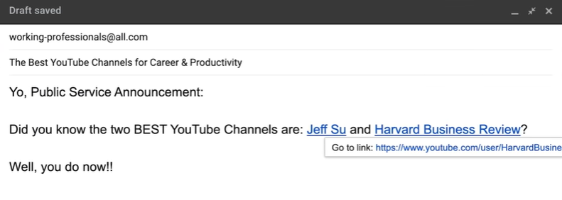

EXPLAIN
Insert hyperlinks
5 MIN
Hyperlink whenever possible
Why?
Email lookers ‘cleaner’ to the recipient
Decreases your chance of making a mistake in the original URL

Slide 13


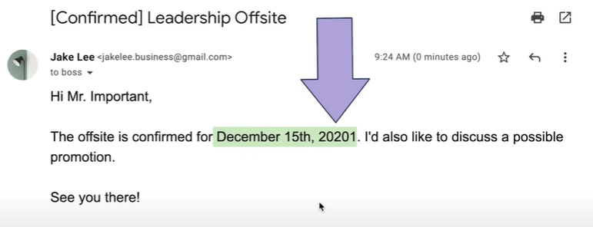
EXPLAIN
Manage your settings
5 MIN
To prevent making a mistake when you are in a rush
Change default setting to reply instead of reply all
Change undo send option to 30 secs
The date is wrong! Of course, the recipient would understand, but this is not professional.

Slide 14
Practice your email writing skills
ACTIVITY 3
30 MIN
We are back in 2025, you are working in the IT sector and need to write an email.
You will have one situation assigned.
Complete the template and have it reviewed by your peer.
TO COMPLETE THIS ACTIVITY :
1
INDIVIDUAL WORK
(20 min)
2
PEER REVIEW
(10 min)

